Slide 1
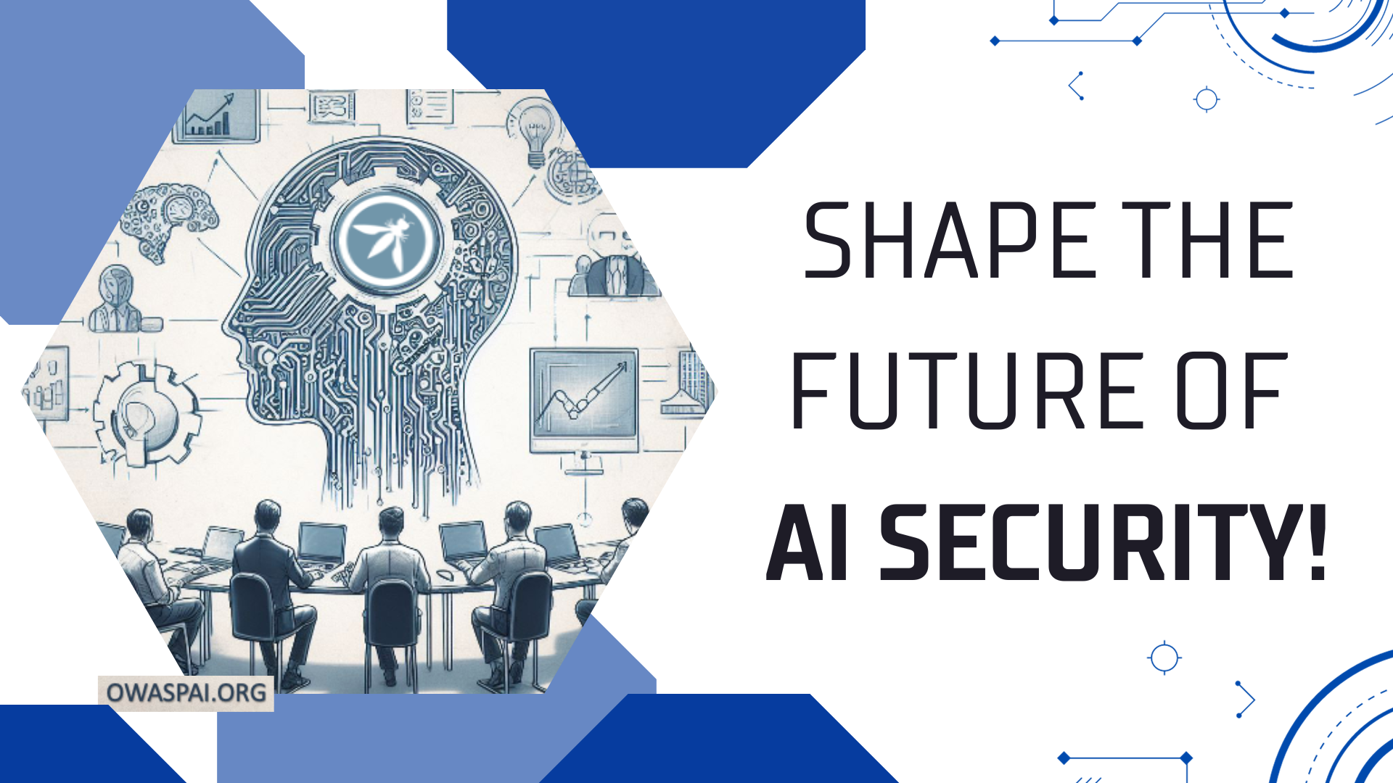

Slide 2



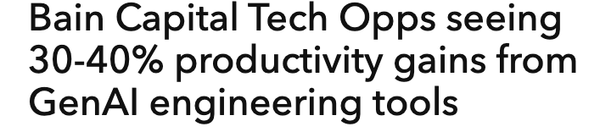

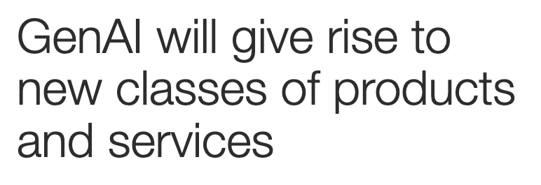
The effects and opportunities of AI are profound
introduction

Slide 3

The effects and opportunities of AI are profound
introduction

Slide 4
What is AI
TK
Introduction
AI
AI System: a machine-based system that can, for a given set of human- defined objectives, make predictions, recommendations, or decisions influencing real or virtual environments
Machine learning
Deep learning
Generative AI
A cat
2.Apply algorithm
1. Train algorithm
Regularities
Examples input and output
4

Slide 5

What is Generative AI
TK
INTRODUCTION
AI
Machine learning
Deep learning
Generative AI
Man’s feline friend is ..
the cat
, a creature admired for its independence, grace, and companionship.
2.Apply algorithm
1. Train algorithm
Regularities
Examples input and output
5

Slide 6

Developing AI systems – start by taking responsibility
Develop an ai system
Step 1: Setup general AI governance*
Keep an inventory of AI initiatives
Perform risk analysis and set requirements
Assign governance roles with responsibilities
Involve stakeholders (CTO, CIO, Legal counsel, DPO)
Step 2: Think before your start, for each idea
Is the application area legal?
Do you really need AI to solve the problem?
Do you have access to the right expertise (e.g. data scientists)?
Are you allowed to use the data for this purpose – given privacy principles?
Can you manage risks of harm by automated or human oversight, security, correctness and minimizing privileges
Can you provide the legally and ethically required transparency into how your AI works?
Can you provide the required privacy rights (access, portabilitu, earuse, correction, objection)?
Can you prevent unwanted bias sufficiently? * see ISO/IEC 42001 AI management

Slide 7
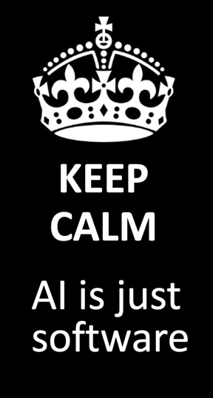
Step 3: Treat production AI for what it is: professional software
Develop an ai system
Include AI in all software engineering practices (see ISO/IEC 5338: https://www.iso.org/standard/81118.html), e.g.:
Including involving AI applications and data scientists in your software security program, e.g:
Quality measurement
Versioning
Documentation
Unit testing
Integration testing
Continuous integration
Continuous delivery
Portfolio management
Knowledge management
Risk analysis
Training
Requirements
Threat modeling
Static analysis
Code review
Pentesting

Slide 8
ISO/IEC 5338 on AI system lifecycle: AI particularities for 12207 (software lifecycle)
Develop an ai system
Start
Design and Development
Verification and Validation
Agreement processes
Architecture definition
Design definition
System analysis
Knowledge acquisition (NEW)
AI data engineering
Implementation
Integration
Acquisition
Supply
Verification
Validation
Monitoring and intervention is part of supply
Special model testing best practices (e.g., validation vs test)
Organizational project-enabling
Inception
Data collection and labelling, Data lineage, data quality, Data preparation, Engineers work with real data
Life cycle model management
Infrastructure management
Portfolio management
Human resource management
Quality management
Knowledge management
Business or mission analysis
Stakeholder needs and requirements definition
System requirement definition
Regulations may forbid your application
Deployment
Transition
Keep model inventory
Contains new Model engineering: Algorithm selection, Training, Tuning, Knowledge programming
Data scientist role
Many new requirement types
Operation and Monitoring
Retirement
Operation
Maintenance
Disposal
Technical management
Consider data destruction
Project planning
Project assessment and control
Decission management
Risk management
Configuration management
Information management
Measurement
Quality assurance
Re-evaluation
Continuous training + Model updates
Quality assurance
Stakeholder needs and requirements definition
Validation
Continuous Validation
New risks
ISO/IEC 5338 – AI Lifecycle
Iteration possible on all paths
Continuous validation
= example of topic
Include train data and models
Detection of staleness or drift

Slide 9
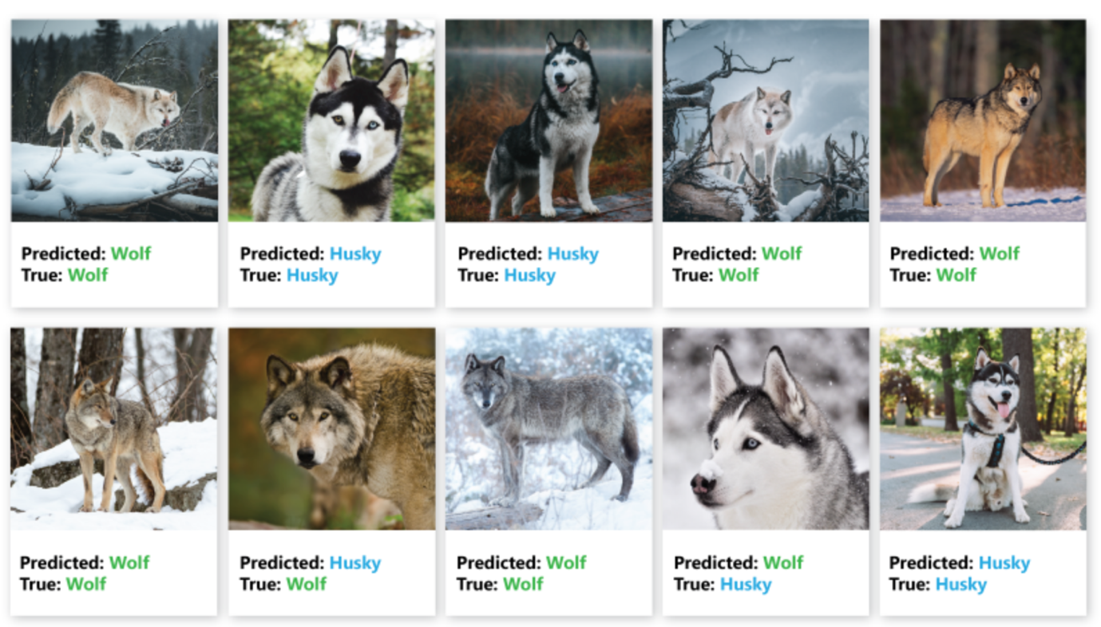
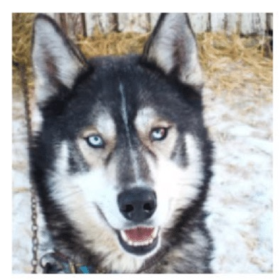

Model attacks – how can AI be fooled?
MODEL ATTACKS
From Besse, Philippe & Castets-Renard, Céline & Garivier, Aurélien & Loubes, Jean-Michel. (2018). Can Everyday AI be Ethical? Machine Learning Algorithm Fairness (english version). 10.13140/RG.2.2.22973.31207.

Slide 10

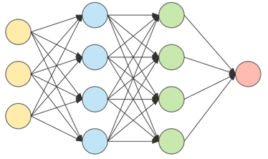


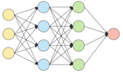
Data poisoning
MODEL ATTACKS
Train set
Model
35Mh
35Mh
Stop
Which traffic sign?
35Mh
Stop
35Mh
35Mh
35Mh
Stop
35Mh !

Slide 11


Input manipulation (closed box)
Model attacks
Speed limit 35
Model
Stop sign
Model

Slide 12


Input manipulation (open box)
MODEL ATTACKS
Adversarial example crafting
+
=
Neural network: Person Yes
Neural network: Person No
parameters
Person Yes/No
Neural network

Slide 13



Model inversion
MODEL ATTACKS
Model inversion
Train set
Neural network

Slide 14



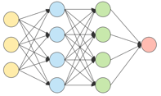

Membership inference
MODEL ATTACKS
Y
Y
N
Smiling Yes/No
N
Y
Y
N
N
Y
Train set
Machine learning
Smiling No, 100% confidence
Smiling Yes, 80% confidence

Slide 15

Model theft
MODEL ATTACKS
Y
Y
N
N
Y
Y
N
Y
N
Input set
Confidential trained machine learning model
Output set
Y
Y
N
N
Y
Y
N
Y
N
Copy of confidential model
Manifactured train set

Slide 16
Threats framework
Training data
Machine learning (optional)
Development- time
AI
Model
Runtime
Input
Application & infrastructure
Output
16

Slide 17
Threats framework
Training data
Machine learning (optional)
Development- time
AI
Model
Runtime
Threats through use:
- Evasion^{(B)}
- Model theft^{(P)}
- Model inversion ^{(T)}
- Data disclosure^{(T)}
- Membership inference^{(T)}
- Denial of model service^{(A)}
- Prompt injection^{(B)}
Input
Application & infrastructure
Output
Impact legend:
(T) Train data confidentiality
(B) Model behaviour
(P) Intellectual property
(A) Availability
(L) Input confidentiality
= threat
17

Slide 18
Threats framework
Development-time threats
- Training data leak^{(T)}
Training data
Machine learning (optional)
- Training data poisoning^{(B)}
(direct or in supply chain)
- Development-time model theft^{(P)}
Development- time
- Development-time model poisoning^{(B)} (direct or in supply chain)
AI
Model
Runtime
Impact legend:
(T) Train data confidentiality
(B) Model behaviour
(P) Intellectual property
(A) Availability
(L) Input confidentiality
= threat
18

Slide 19
Threats framework
Training data
Machine learning (optional)
Development- time
AI
Model
Runtime
- Runtime model theft^{(P)}
- Runtime model poisoning^{(B)}
Input
Application & infrastructure
Output
-Input leak^{(L)}
- Output contains injection attack
Impact legend:
(T) Train data confidentiality
(B) Model behaviour
(P) Intellectual property
(A) Availability
(L) Input confidentiality
- Conventional security threats: bypassing model access control, compromising plugins, etc. (e.g. SQL injection, password guessing)
Runtime security threats
= threat
19

Slide 20
Threats framework
Development-time threats
- Training data leak^{(T)}
Training data
Machine learning (optional)
- Training data poisoning^{(B)}
(direct or in supply chain)
- Development-time model theft^{(P)}
Development- time
- Development-time model poisoning^{(B)} (direct or in supply chain)
AI
Model
Runtime
- Runtime model theft^{(P)}
- Runtime model poisoning^{(B)}
Threats through use:
- Evasion^{(B)}
- Model theft^{(P)}
- Model inversion ^{(T)}
- Data disclosure^{(T)}
- Membership inference^{(T)}
- Denial of model service^{(A)}
- Prompt injection^{(B)}
Input
Application & infrastructure
Output
-Input leak^{(L)}
- Output contains injection attack
Impact legend:
(T) Train data confidentiality
(B) Model behaviour
(P) Intellectual property
(A) Availability
(L) Input confidentiality
- Conventional security threats: bypassing model access control, compromising plugins, etc. (e.g. SQL injection, password guessing)
Runtime security threats
= threat
20

Slide 21
AI security threats overview
Ai security threats

Slide 22
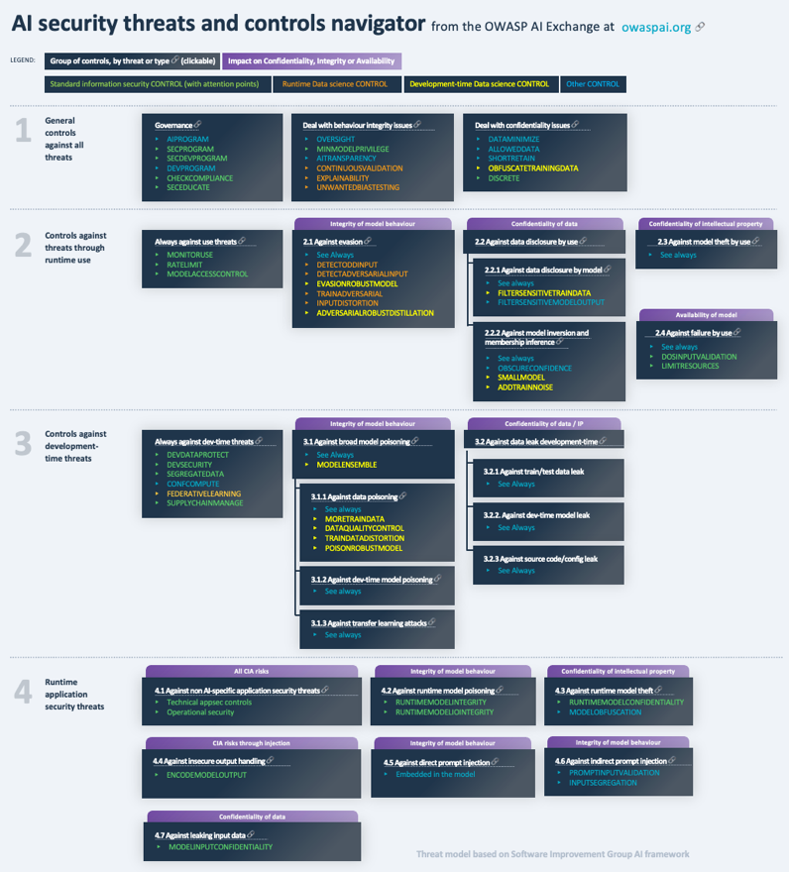
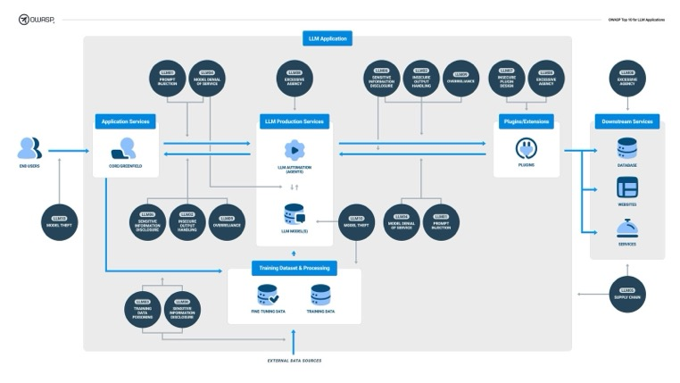
Follow the AI Exchange & LLM top 10 - owaspai.org & LLMtop10.com

Slide 23
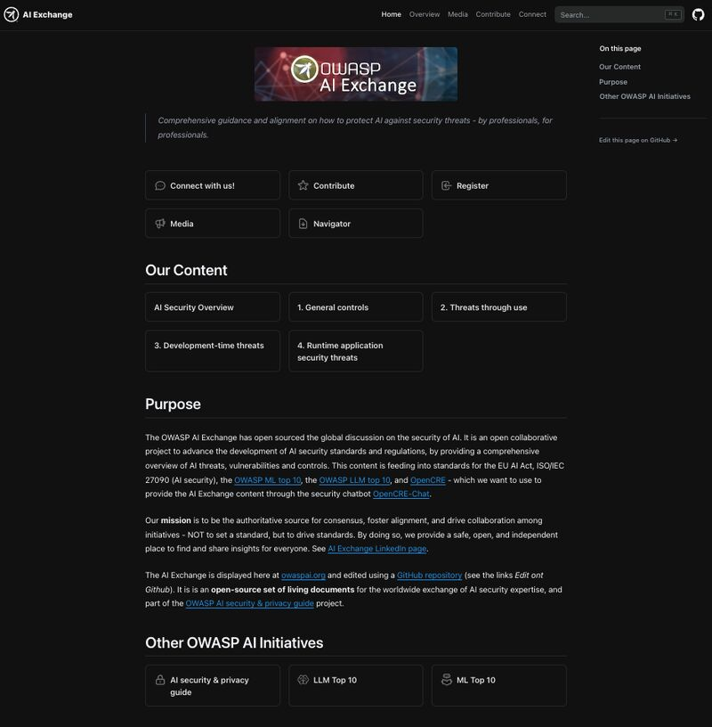
OWASP AI Exchange at owaspai.org
OWASP project since Q4 2022
Open sources the AI security discussion
Cross-geo, cross-domain, cross-industry
Copyright and attribution-free
Active liaisons: CEN/CENELEC, CSA, ISO 27090, NIST, MITRE, NCSCs, AISIC, ITU, ETSI
Content adopted verbatim by CEN/CENELEC JTC 21 for the AI Act
PUBLIC

Slide 24

AI Exchange feeding into ISO/IEC 27090 and the AI Act, through CEN/CENELEC JTC21/WG5
Collaboration activities with Alan Turing, CSA, NIST, MITRE, ITU, ETSI, ISO/IEC 27090, ISO/IEC 27091, AISIC, LLM/ML top 10
Further contributions and validation by experts cross continent/domain
WG5
By CEN/CENELEC:
Review
and validation with ENISA (Securing ML algorithms 2021)
Mar 2024
Open source expert contributions.
Adversarial machine learning experts
Cyber security experts
Generative AI experts
Validated with:
ENISA
NIST
MITRE
Microsoft
BIML
ETSI
Google
ISO/IEC 27090

Slide 25
Step 4: Protect AI with development-time controls
Trao
Development-time threats
2. Model and data supply chain management
1. AI governance
- Training data leak^{(T)}
Training data
Machine learning (optional)
2. Conventional development environment security
- Training data poisoning^{(B)}
(direct or in supply chain)
- Development-time model theft^{(P)}
3a.Datascience controls against poisoning, evasion and data disclosure
Development- time
- Development-time model poisoning^{(B)} (direct or in supply chain)
AI
Model
Runtime
- Runtime model theft^{(P)}
Development-time data science model attack prevention:
Federative learning
Ensemble models
Train data augmentation
Train data distortion
Robust model design
Data quality control
- Runtime model poisoning^{(B)}
Application & infrastructure
Obfuscate train data
Model testing
Adversarial distillation
Filter sensitive train data
Add train noise
Model size minimization
Threats through use:
- Evasion^{(B)}
- Model theft^{(P)}
- Model inversion ^{(T)}
- Data disclosure^{(T)}
- Membership inference^{(T)}
- Denial of model service^{(A)}
- Prompt injection^{(B)}
Input
Output
-Input leak^{(L)}
- Output contains injection attack
Impact legend:
(T) Train data confidentiality
(B) Model behaviour
(P) Intellectual property
(A) Availability
(L) Input confidentiality
- Conventional security threats: bypassing model access control, compromising plugins, etc. (e.g. SQL injection, password guessing)
Runtime security threats
= threat
= control group
//Source: AI threat model by Software Improvement Group, donated to AI Exchange, free of copyright and attribution

Slide 26
Step 5: Protect AI with runtime controls
Trao
Development-time threats
- Training data leak^{(T)}
Training data
Machine learning (optional)
- Training data poisoning^{(B)}
(direct or in supply chain)
- Development-time model theft^{(P)}
Development- time
- Development-time model poisoning^{(B)} (direct or in supply chain)
AI
Model
Runtime
- Runtime model theft^{(P)}
2b. Monitor, rate limit, access control
- Runtime model poisoning^{(B)}
Threats through use:
- Evasion^{(B)}
- Model theft^{(P)}
- Model inversion ^{(T)}
- Data disclosure^{(T)}
- Membership inference^{(T)}
- Denial of model service^{(A)}
- Prompt injection^{(B)}
Input
Application & infrastructure
Output
3b. Datascience input filtering and detection
-Input leak^{(L)}
- Output contains injection attack
Impact legend:
(T) Train data confidentiality
(B) Model behaviour
(P) Intellectual property
(A) Availability
(L) Input confidentiality
2. Runtime technical security: conventional + new
- Conventional security threats: bypassing model access control, compromising plugins, etc. (e.g. SQL injection, password guessing)
Runtime security threats
= threat
= control group
//Source: AI threat model by Software Improvement Group, donated to AI Exchange, free of copyright and attribution

Slide 27
Step 6: Limit impact
Trao
Development-time threats
- Training data leak^{(T)}
Training data
Machine learning (optional)
4. Minimize data^{(T,P,L)}
- Training data poisoning^{(B)}
(direct or in supply chain)
- Development-time model theft^{(P)}
Development- time
- Development-time model poisoning^{(B)} (direct or in supply chain)
AI
Model
Runtime
- Runtime model theft^{(P)}
- Runtime model poisoning^{(B)}
Threats through use:
- Evasion^{(B)}
- Model theft^{(P)}
- Model inversion ^{(T)}
- Data disclosure^{(T)}
- Membership inference^{(T)}
- Denial of model service^{(A)}
- Prompt injection^{(B)}
Input
Application & infrastructure
Output
5. Control behaviour impact e.g. oversight, validation ^{(B)}
-Input leak^{(L)}
- Output contains injection attack
Impact legend:
(T) Train data confidentiality
(B) Model behaviour
(P) Intellectual property
(A) Availability
(L) Input confidentiality
4. Minimize data^{(T,P,L)}
- Conventional security threats: bypassing model access control, compromising plugins, etc. (e.g. SQL injection, password guessing)
Runtime security threats
= threat
= control group
//Source: AI threat model by Software Improvement Group, donated to AI Exchange, free of copyright and attribution

Slide 28

How to limit impact
Ai security controls
Minimize (sensitive) data
Minimize data in rest and in transit
Obfuscate data where possible
Keep data as short as possible
Minimize technical details (e.g. output but also: publications)
Ensemble models, federative learning
Control behavior impact
Arrange automated or human oversight
Assign minimal privileges to model actions
Be transparent / explain
Arrange proper correctness testing, continuous validation including unwanted bias testing

Slide 29
Third-party cloud-hosted pre-trained/finetuned GenAI: theat model with control groups
As-is GenAI model (externally trained/finetuned) with risks of model manipulation (data/model poisoning) and sensitive/copyrighted data
Model
External
Internal
2. Model supply chain management
1. AI governance
2b. Monitor, rate limit, access control
- Runtime model poisoning^{(B)}
Threats through use:
- Denial of model service^{(A)}
- Prompt injection^{(B)}
Input
Application & infrastructure
Output
5. Control behaviour impact e.g. oversight, validation ^{(B)}
-Input leak^{(L)}
- Output contains injection attack
2. Runtime technical security: conventional + new
4. Minimize data^{(T,P,L)}
Impact legend:
(B) Model behaviour
(A) Availability
(L) Input confidentiality
- Conventional security threats: bypassing model access control, compromising plugins, etc. (e.g. SQL injection, password guessing)
= threat
Runtime security threats
= control group

Slide 30

Recap of steps when developing AI solutions: security for AI
Step 1: Setup governance
Step 2: Think before your start, for each idea
Step 3: Treat production AI for what it is: professional software
Step 4: Protect AI with development-time controls
Step 5:Protect AI with runtime controls
Step 6: Limit impact

Slide 31
References
OWASP AI Exchange: https://owaspai.org/
OWASP AI security & privacy guide: https://owasp.org/www-project-ai-security-and-privacy-guide/
OWASP LLM top 10: https://llmtop10.com/
ISO/IEC 5338: https://www.softwareimprovementgroup.com/iso-5338-get-to-know-the-global-standard-on-ai-systems/
ENISA multilayer AI security framework https://www.enisa.europa.eu/publications/multilayer-framework-for-good-cybersecurity-practices-for-ai
ENISA on securing ML: https://www.enisa.europa.eu/publications/securing-machine-learning-algorithms
NIST AI Risk Management Framework 1.0 https://doi.org/10.6028/NIST.AI.100-1
ENISA AI security standard discussion https://www.enisa.europa.eu/publications/cybersecurity-of-ai-and-standardisation
MITRE ATLAS framework for AI threats. https://atlas.mitre.org/
OpenCRE – universal catalog of common security controls: https://www.opencre.org/

Slide 32
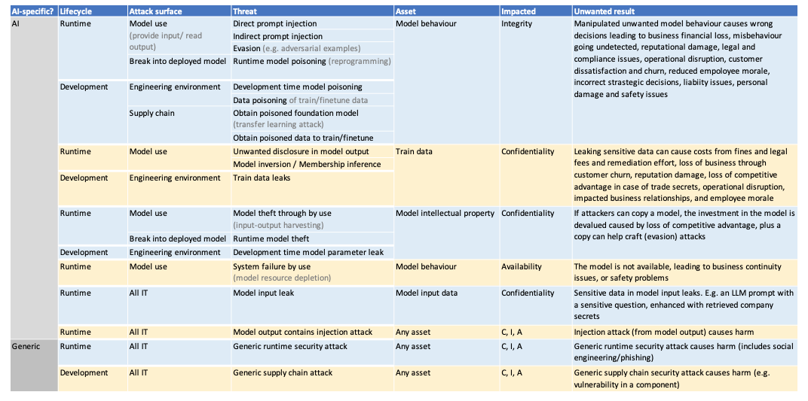
AI threats in table form

Slide 33
Risk identification, estimation and evaluation
No GenAI

Slide 34
Risk identification, estimation and evaluation
No GenAI
Low actor motivation -> low risk

Slide 35
Risk identification, estimation and evaluation
No GenAI
Low actor motivation -> low risk
Risk accepted given security measures in place

Slide 36
Risk identification, estimation and evaluation
No GenAI
No data or model from supplier
Low actor motivation -> low risk
Risk accepted given security measures in place

Slide 37
Risk identification, estimation and evaluation
No GenAI
No data or model from supplier
Low actor motivation -> low risk
Risk accepted given security measures in place
Train data is not confidential

